Slide 1
UNIT 5: Chapter 5
ANOVA

Slide 2

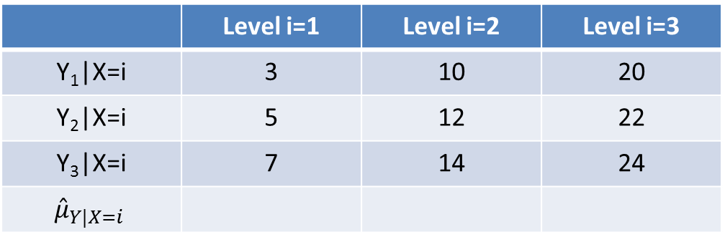
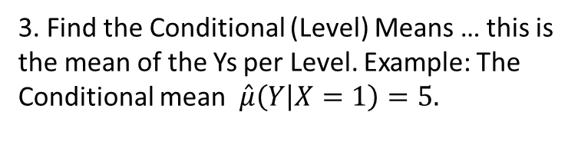
ANOVA
1. Make a Scatterplot of the data in the table below. “Level” is
the Explanatory Variable (X=1, 2, or 3).
 | Level i=1 | Level i=2 | Level i=3
Y₁|X=i | 3 | 10 | 20
Y₂|X=i | 5 | 12 | 22
Y₃|X=i | 7 | 14 | 24
$${\hat{μ}}_{Y|X=i}$$
2. Find the Grand Mean … this is the mean of all the Ys together … regardless of Level.
$$\hat{μ}=\overset{̿}{x}=$$
3. Find the Conditional (Level) Means … this is the mean of the Ys per Level. Example: The Conditional mean $\hat{μ}\left(Y | X=1\right)=5.$

Slide 3

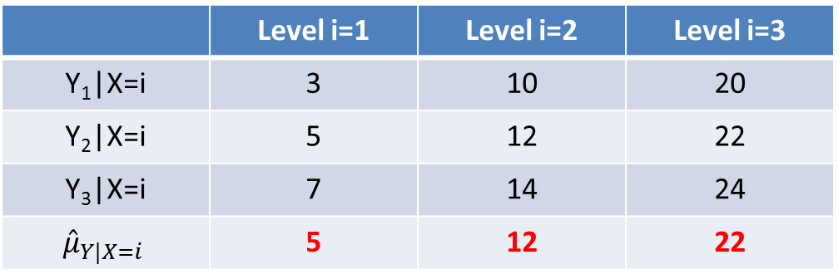
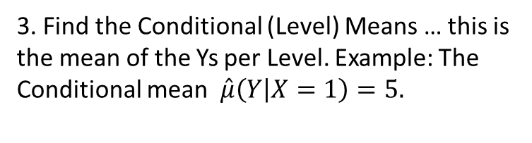
ANOVA
1. Make a Scatterplot of the data in the table below. “Level” is
the Explanatory Variable (X=1, 2, or 3).
 | Level i=1 | Level i=2 | Level i=3
Y₁|X=i | 3 | 10 | 20
Y₂|X=i | 5 | 12 | 22
Y₃|X=i | 7 | 14 | 24
$${\hat{μ}}_{Y|X=i}$$ | 5 | 12 | 22
2. Find the Grand Mean … this is the mean of the sample means. If the sample size is the same in each group, then this is the mean of all the Ys together … regardless of Level.
$$\hat{μ}=\overset{̿}{x}=\text{13}$$
3. Find the Conditional (Level) Means … this is the mean of the Ys per Level. Example: The Conditional mean $\hat{μ}\left(Y | X=1\right)=5.$

Slide 4

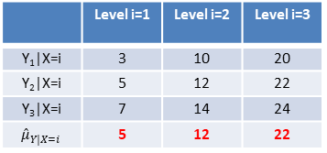
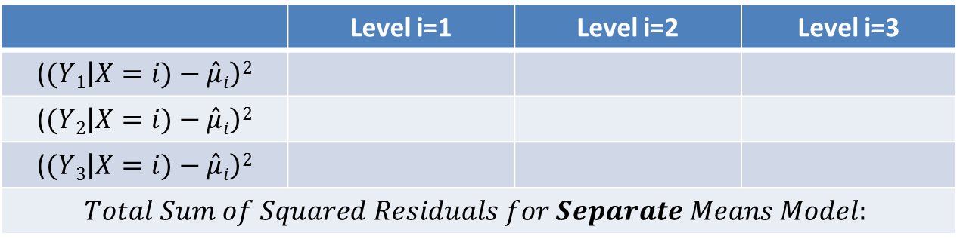
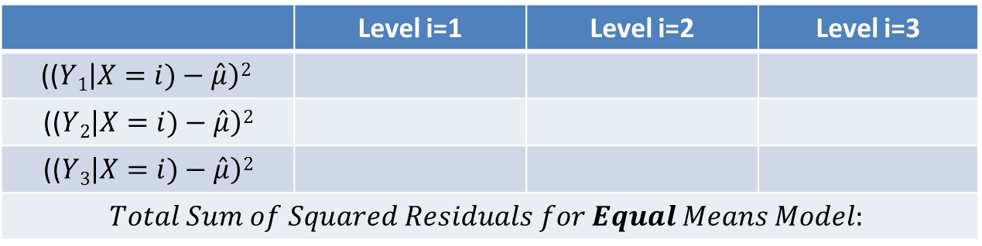
Pure ANOVA
 | Level i=1 | Level i=2 | Level i=3
Y₁|X=i | 3 | 10 | 20
Y₂|X=i | 5 | 12 | 22
Y₃|X=i | 7 | 14 | 24
$${\hat{μ}}_{Y|X=i}$$ | 5 | 12 | 22
4. Now we need to find the Sum of the Squared Residuals for the Equal Means Model.
$$\hat{μ}=\overset{̿}{x}=\text{13}$$
($(Yi\left|X)−\hat{μ}\right)2$
 | Level i=1 | Level i=2 | Level i=3
(($Y1\left|X=i)−\hat{μ}\right)2$
(($Y2\left|X=i)−\hat{μ}\right)2$
(($Y3\left|X=i)−\hat{μ}\right)2$
$$Total Sum of Squared Residuals for Equal Means Model:$$
5. Now we need to find the Sum of the Squared Residuals for the Separate Means Model, where $\hat{μ}i$ = $\hat{μ}(Y|X=i)$.
($(Yi\left|X=i)−\hat{μ}i\right)2$
 | Level i=1 | Level i=2 | Level i=3
($(Y1\left|X=i)−\hat{μ}i\right)2$
($(Y2\left|X=i)−\hat{μ}i\right)2$
($(Y3\left|X=i)−\hat{μ}i\right)2$
$$Total Sum of Squared Residuals for Separate Means Model:$$
6. Compare the Total Sum of Squares for each model. Which do you think “fits” better?

Slide 5

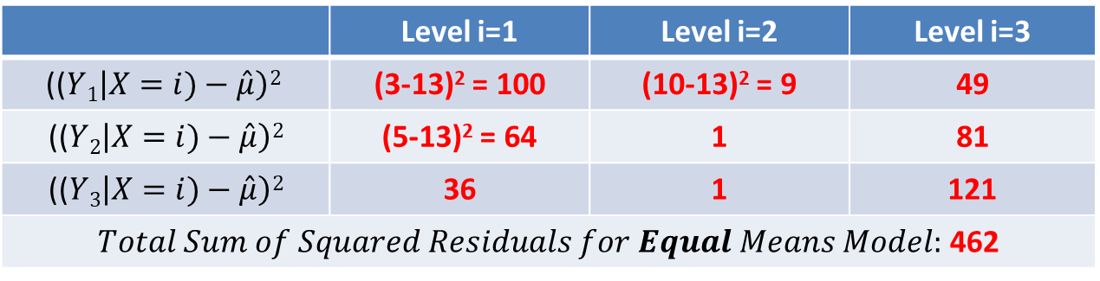
Pure ANOVA
 | Level i=1 | Level i=2 | Level i=3
Y₁|X=i | 3 | 10 | 20
Y₂|X=i | 5 | 12 | 22
Y₃|X=i | 7 | 14 | 24
$${\hat{μ}}_{Y|X=i}$$ | 5 | 12 | 22
4. Now we need to find the Sum of the Squared Residuals for the Equal Means Model.
$$\hat{μ}=\overset{̿}{x}=\text{13}$$
($(Yi\left|X)−\hat{μ}\right)2$
 | Level i=1 | Level i=2 | Level i=3
(($Y1\left|X=i)−\hat{μ}\right)2$ | (3-13)² = 100 | (10-13)² = 9 | 49
(($Y2\left|X=i)−\hat{μ}\right)2$ | (5-13)² = 64 | 1 | 81
(($Y3\left|X=i)−\hat{μ}\right)2$ | 36 | 1 | 121
$Total Sum of Squared Residuals for Equal Means Model:$ 462
5. Now we need to find the Sum of the Squared Residuals for the Separate Means Model, where $\hat{μ}i$ = $\hat{μ}(Y|X=i)$.
($(Yi\left|X=i)−\hat{μ}i\right)2$
 | Level i=1 | Level i=2 | Level i=3
($(Y1\left|X=i)−\hat{μ}i\right)2$
($(Y2\left|X=i)−\hat{μ}i\right)2$
($(Y3\left|X=i)−\hat{μ}i\right)2$
$Total Sum of Squared Residuals for Separate Means Model:$
6. Compare the Total Sum of Squares for each model. Which do you think “fits” better?

Slide 6
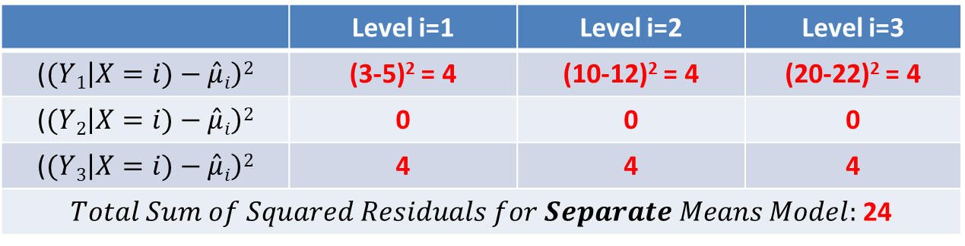
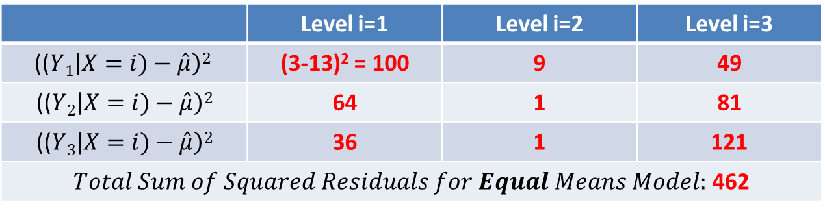
Pure ANOVA
 | Level i=1 | Level i=2 | Level i=3
Y₁|X=i | 3 | 10 | 20
Y₂|X=i | 5 | 12 | 22
Y₃|X=i | 7 | 14 | 24
$${\hat{μ}}_{Y|X=i}$$ | 5 | 12 | 22
4. Now we need to find the Sum of the Squared Residuals for the Equal Means Model.
$$\hat{μ}=\overset{̿}{x}=\text{13}$$
($(Yi\left|X)−\hat{μ}\right)2$
 | Level i=1 | Level i=2 | Level i=3
(($Y1\left|X=i)−\hat{μ}\right)2$ | (3-13)² = 100 | 9 | 49
(($Y2\left|X=i)−\hat{μ}\right)2$ | 64 | 1 | 81
(($Y3\left|X=i)−\hat{μ}\right)2$ | 36 | 1 | 121
$Total Sum of Squared Residuals for Equal Means Model:$ 462
5. Now we need to find the Sum of the Squared Residuals for the Separate Means Model, where $\hat{μ}i$ = $\hat{μ}(Y|X=i)$.
($(Yi\left|X=i)−\hat{μ}i\right)2$
 | Level i=1 | Level i=2 | Level i=3
($(Y1\left|X=i)−\hat{μ}i\right)2$ | (3-5)² = 4 | (10-12)² = 4 | (20-22)² = 4
($(Y2\left|X=i)−\hat{μ}i\right)2$ | 0 | 0 | 0
($(Y3\left|X=i)−\hat{μ}i\right)2$ | 4 | 4 | 4
$Total Sum of Squared Residuals for Separate Means Model:$ 24
6. Compare the Total Sum of Squares for each model. Which do you think “fits” better?

Slide 7
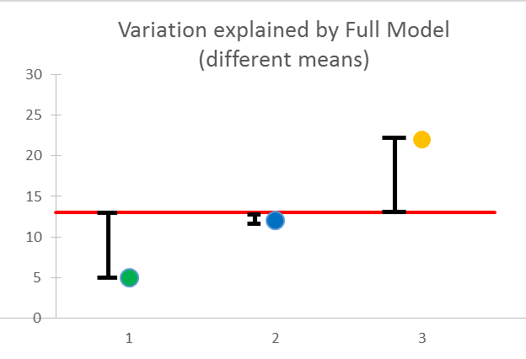
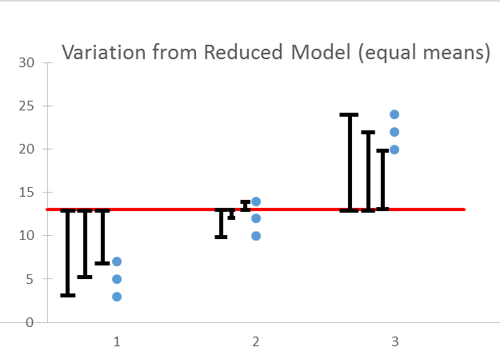
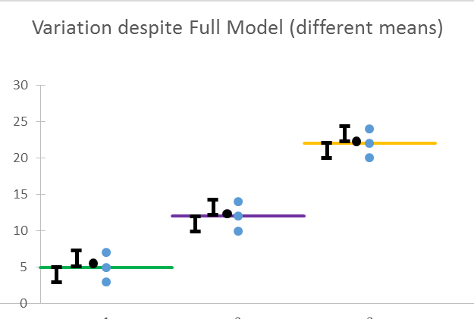
Sum of Squares in ANOVA
Between group variation (top row)
Total variation (bottom row)
Within group variation (middle row)
*To compute the sum of squares column for the ANOVA table, square each distance (lines in black) and then add.
The sum of squared distances (black lines) for left two graphs = the sum of squared distances (black lines) for the right graph.

Slide 8
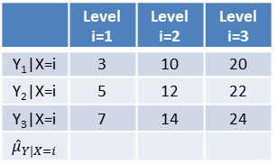
Pure ANOVA
 | Level i=1 | Level i=2 | Level i=3
Y₁|X=i | 3 | 10 | 20
Y₂|X=i | 5 | 12 | 22
Y₃|X=i | 7 | 14 | 24
$${\hat{μ}}_{Y|X=i}$$
7. Now we would like to make an ANOVA table to test the alternative hypothesis!
Formally write the Ho and Ha and fill in the table.
 | df | SS | MS | F | Pr > F
Model / Extra SS
Error / Residual/Full Model
Total (Reduced)
Extra Sum of Squares = Residual Sum of Squares Reduced – Residual Sum of Squares Full

Slide 9
Pure ANOVA
7. Now we would like to make an ANOVA table to test the alternative hypothesis!
Formally write the Ho and Ha and fill in the table.
Ho: µ₁= µ₂ = µ₃ (Equal Means Model µ µ µ)
Ha: At least 1 pair are different (Separate Means Model µ₁ µ₂ µ₃)
 | df | SS | MS | F | Pr > F
Model / Extra SS
Error / Residual/Full Model | 6 | 24 | 4
Total (Reduced) | 8 | 462
Extra Sum of Squares = Residual Sum of Squares Reduced – Residual Sum of Squares Full

Slide 10
Pure ANOVA
7. Now we would like to make an ANOVA table to test the alternative hypothesis!
Formally write the Ho and Ha and fill in the table.
Ho: µ₁= µ₂ = µ₃ (Equal Means Model µ µ µ)
Ha: At least 1 pair are different (Separate Means Model µ₁ µ₂ µ₃)
 | df | SS | MS | F | Pr > F
Model / Extra SS | 8-6=2 | 462-24=438
Error / Residual/Full Model | 6 | 24 | 4
Total (Reduced) | 8 | 462
Extra Sum of Squares = Residual Sum of Squares Reduced – Residual Sum of Squares Full

Slide 11
Pure ANOVA
7. Now we would like to make an ANOVA table to test the alternative hypothesis!
Formally write the Ho and Ha and fill in the table.
Ho: µ₁= µ₂ = µ₃ (Equal Means Model µ µ µ)
Ha: At least 1 pair are different (Separate Means Model µ₁ µ₂ µ₃)
 | df | SS | MS | F | Pr > F
Model / Extra SS | 2 | 438 | 438/2=219
Error / Residual/Full Model | 6 | 24 | 4
Total (Reduced) | 8 | 462
Extra Sum of Squares = Residual Sum of Squares Reduced – Residual Sum of Squares Full

Slide 12
Pure ANOVA
7. Now we would like to make an ANOVA table to test the alternative hypothesis!
Formally write the Ho and Ha and fill in the table.
Ho: µ₁= µ₂ = µ₃ (Equal Means Model µ µ µ)
Ha: At least 1 pair are different (Separate Means Model µ₁ µ₂ µ₃)
 | df | SS | MS | F | Pr > F
Model / Extra SS | 2 | 438 | 219 | 219/4=54.75
Error / Residual/Full Model | 6 | 24 | 4
Total (Reduced) | 8 | 462
Extra Sum of Squares = Residual Sum of Squares Reduced – Residual Sum of Squares Full

Slide 13
Pure ANOVA
7. Now we would like to make an ANOVA table to test the alternative hypothesis!
Formally write the Ho and Ha and fill in the table.
Ho: µ₁= µ₂ = µ₃ (Equal Means Model µ µ µ)
Ha: At least 1 pair are different (Separate Means Model µ₁ µ₂ µ₃)
 | df | SS | MS | F | Pr > F
Model / Extra SS | 2 | 438 | 219 | 54.75 | .0001
Error / Residual/Full Model | 6 | 24 | 4
Total (Reduced) | 8 | 462
Extra Sum of Squares = Residual Sum of Squares Reduced – Residual Sum of Squares Full

Slide 14
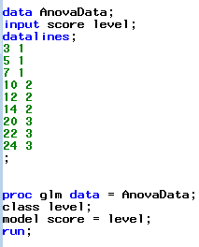
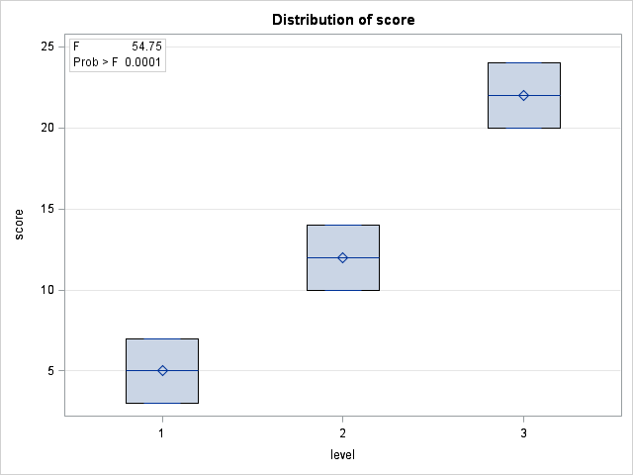
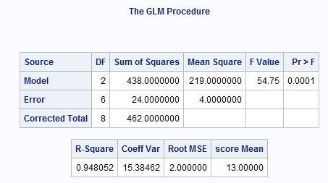
F -Test of Different Means …
Ho: µ₁= µ₂ = µ₃ (Equal Means Model)
Ha: At least 1 pair are different (Separate Means Model)

Slide 15

6 Steps for ANOVA F Test (diff means)!
1.
Ho: µ₁= µ₂ = µ₃ (Equal Means Model)
Ha: At least 1 pair are different (Separate Means Model)
2.
Critical value: You can skip this step for ANOVA.
3.
F statistic = 54.75
4.
P-value < .0001
5.
Reject Ho.
6.
The evidence suggests that at least 1 pair of the group means are different. (P-value < .0001 from an ANOVA.)

Slide 16
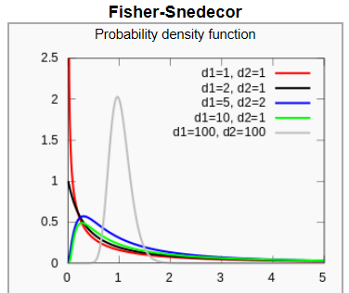
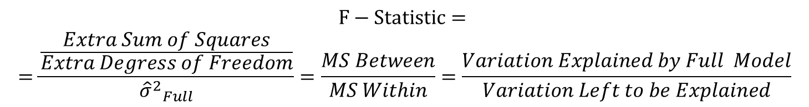
F-Distribution
$$F−Statistic=$$
$$=\frac{\frac{Extra Sum of Squares}{Extra Degress of Freedom}}{{{\hat{σ}}^{2}}_{Full}}=\frac{MS Between}{MS Within}=\frac{Variation Explained by Full Model}{Variation Left to be Explained}$$

Slide 17
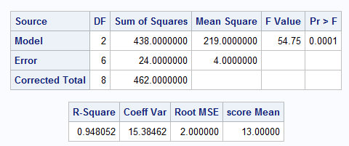
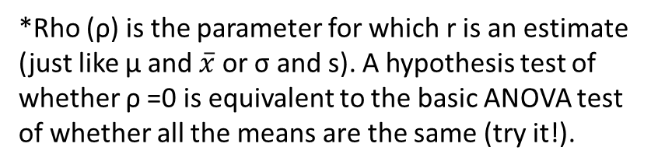
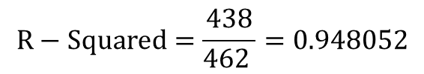
R-Squared!
R =correlation coefficient R² = coefficient of determination
$$R−Squared=\frac{Variation Explained by Full Model}{Total Variation }=\frac{Extra Sum of Squares}{Total Sum of Squares}$$
$$R−Squared=\frac{438}{462 }=0.948052$$
*Rho (ρ) is the parameter for which r is an estimate (just like μ and $\overline{x}$ or σ and s). A hypothesis test of whether ρ =0 is equivalent to the basic ANOVA test of whether all the means are the same (try it!).

Slide 18
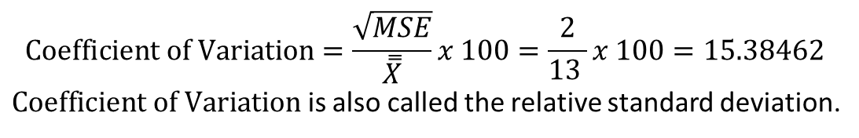
Coefficient of Variation
$$Coefficient of Variation=\frac{square root of the unexplained variation}{grand mean }x 100\%$$
$$Coefficient of Variation=\frac{\sqrt{MSE}}{\overset{̿}{X}}x 100=\frac{2}{13 }x 100=15.38462$$
$Coefficient of Variation$ is also called the relative standard deviation.

Slide 19
ANOVA: Assumptions and Robustness
Normality: Similar to t-tools hypothesis testing, ANOVA is robust to this assumption. Extremely long-tailed distributions (outliers) or skewed distributions, coupled with different sample sizes (especially when the sample sizes are small) present the only serious distributional problems.
Equal Standard Deviations: This assumption is crucial, paramount, and VERY important.
The assumptions of independence within and across groups are critical. If lacking, different analysis should be attempted.

Slide 20
Samples drawn from Normal Distributions
Same visual checks as with t-tools, just for more groups.
Histograms
Q-Q plots

Slide 21
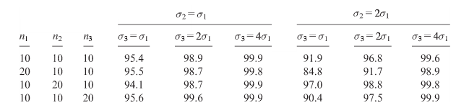
More on Constant SD
95% confidence interval accuracy with different sample sizes and standard deviations for three groups.

Slide 22
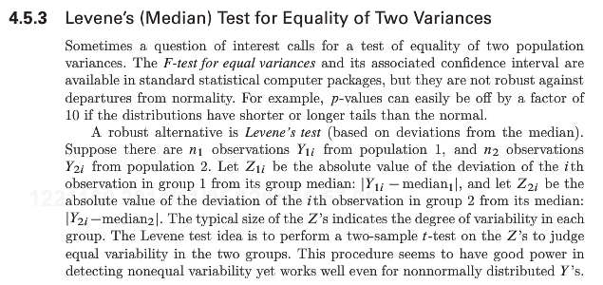
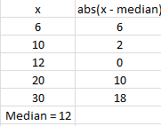
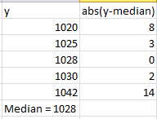

Levene’s Test (Median)
Ho: σ₁= σ₂
Ha: σ₁≠ σ₂
But … proc ttest does not have Levene’s Test!!!

Slide 23

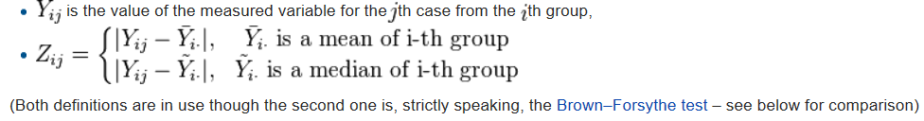

Proc GLM Has Levene’s Test

Slide 24
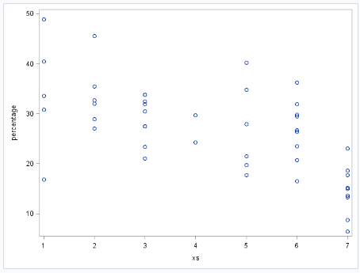
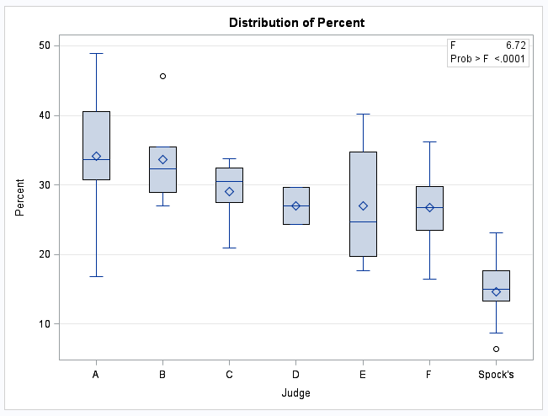

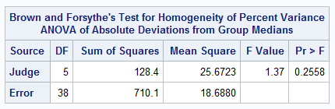

Check of Assumptions: Constant SD
There is some visual evidence against equal standard deviations. The Brown-Forsythe test was used as secondary evidence and does not provide significant evidence against equal standard deviations. (p-value = .2558)

Slide 25
Archeology in New Mexico
An archeological dig in New Mexico yielded four sites with lots of artifacts. The depth (cm) that each artifact was found was recorded along with which site it was found in.
The researcher has reason to believe that sites 1 and 4 and sites 2 and 3 may be similar in age. In theory, the deeper the find, the older the village.
Is there any evidence that sites 1 and 4 have a mean depth that is different than the mean depth of artifacts from sites 2 and 3?

Slide 26
Archaeology Example
Depth | Site |  | Depth | Site |  | Depth | Site |  | Depth | Site
93 | 1 |  | 85 | 2 |  | 100 | 3 |  | 96 | 4
120 | 1 |  | 45 | 2 |  | 75 | 3 |  | 58 | 4
65 | 1 |  | 80 | 2 |  | 65 | 3 |  | 95 | 4
105 | 1 |  | 28 | 2 |  | 40 | 3 |  | 90 | 4
115 | 1 |  | 75 | 2 |  | 73 | 3 |  | 65 | 4
82 | 1 |  | 70 | 2 |  | 65 | 3 |  | 80 | 4
99 | 1 |  | 65 | 2 |  | 50 | 3 |  | 85 | 4
87 | 1 |  | 55 | 2 |  | 30 | 3 |  | 95 | 4
100 | 1 |  | 50 | 2 |  | 45 | 3 |  | 82 | 4
90 | 1 |  | 40 | 2 |  | 50 | 3
78 | 1 |  |  |  |  | 45 | 3
95 | 1 |  |  |  |  | 55 | 3
93 | 1
88 | 1
110 | 1

Slide 27
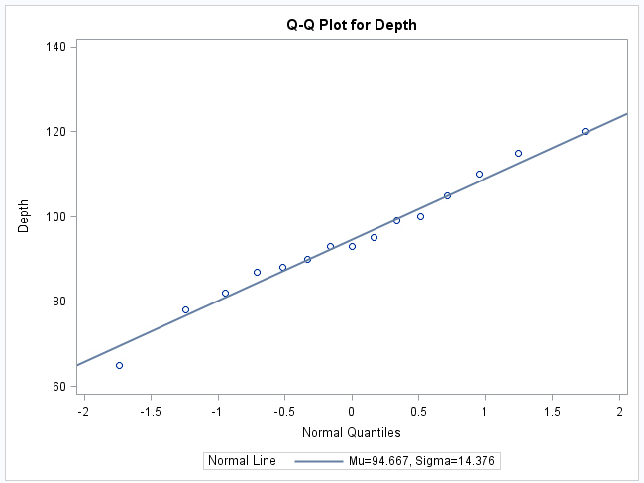
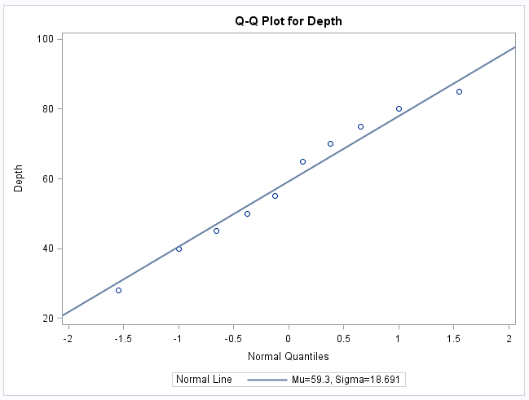
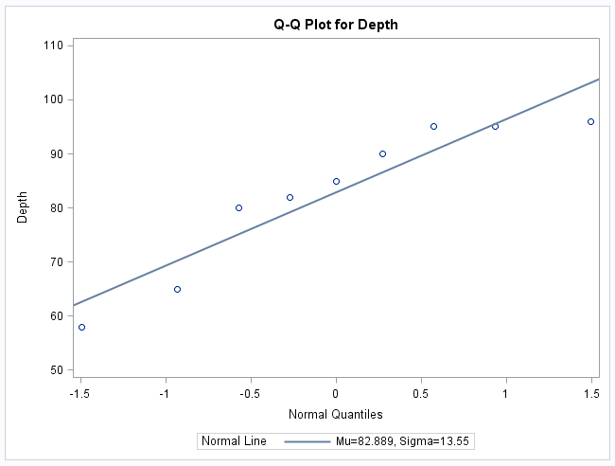
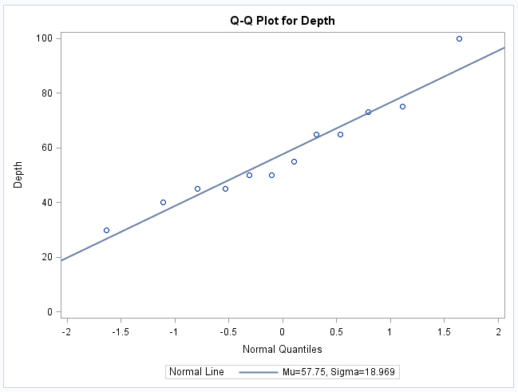
Archeology Example Assumptions: Normality
Histograms will be helpful as well!

Slide 28
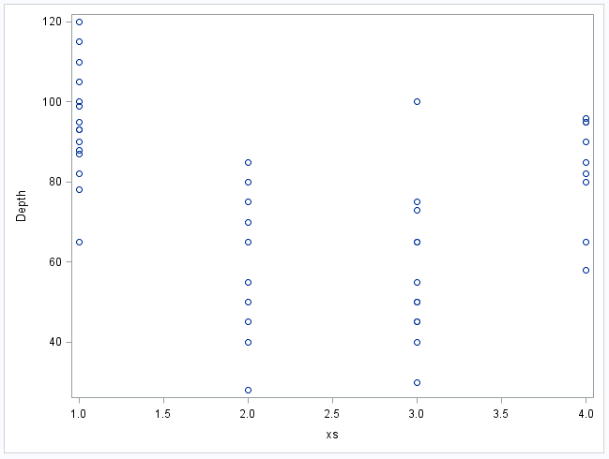
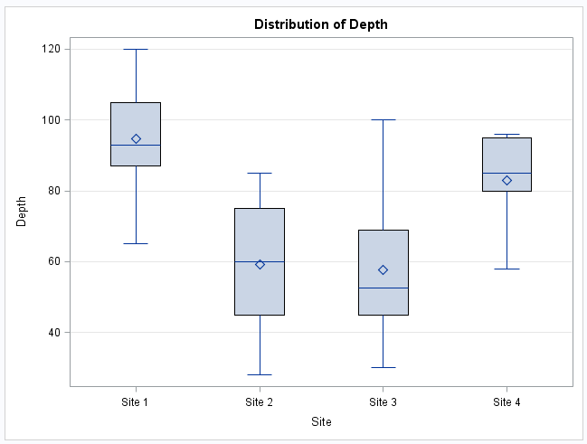
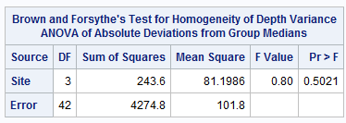
Archeology Example Assumptions: Homogeneity (Equal SD)

Slide 29
Archeology Example Assumption: Independence
The discovered artifacts associated with the depths were randomly selected from the log (book of recordings … not logarithms!) of discoveries.
Since the artifacts and, thus, the depths are associated with completely different sites, it is assumed that the data are independent between sites.

Slide 30
Question of Interest:
1. Are any of the means different?
2. Are the means of sites 1 and 4 different?
3. Are the means of sites 2 and 3 different?
4. Satisfactory results of questions 1 and 2 will allow us to ask the third question: are sites 1 and 4 different than 2 and 3?

Slide 31
Are sites 1 and 4 different from 2 and 3? *Assumes ANOVA assumptions are met
Perform regular ANOVA to test if any of the means are different from the rest.
Reduced Model Ho: µ µ µ µ
Full Model Ha: µ₁ µ₂ µ₃ µ₄
BYO ANOVA to test if the means of 2 and 3 are different, given at least one pair is different.
Reduced Model Ho: µ₁ µ₀ µ₀ µ₄
Full Model Ha: µ₁ µ₂ µ₃ µ₄
Stop: Groups 2 and 3 are different and should not be treated as having the same means, as the QoI suggests.
Reject Ho in favor of Ha: µ₁ µ₂ µ₃ µ₄?
Reject Ho in favor of Ha: µ₁ µ₂ µ₃ µ₄?
Stop: Insufficient evidence that any means are different
no
yes
yes
no
BYO ANOVA to test if the means of 1 and 4 are different, given at least one pair is different.
Reduced Model Ho: µ₀ µ₂ µ₃ µ₀
Full Model Ha: µ₁ µ₂ µ₃ µ₄
Perform ANOVA to test if the means of 1 and 4, when taken together are different than means 2 and 3, when also taken together.
Reduced Model Ho: µ µ µ µ
Full Model Ha: µ_{a} µ_{b} µ_{b} µ_{a}
Stop: Groups 1 and 4 are different and should not be treated as having the same means, as the QoI suggests.
Stop: Evidence does NOT support the claim in QoI
Reject Ho in favor of Ha: µ₁ µ₂ µ₃ µ₄?
Reject Ho in favor of Ha: µ_{a} µ_{b} µ_{b} µ_{a}?
yes
no
Stop: Evidence does support the claim in QoI
no
yes

Slide 32
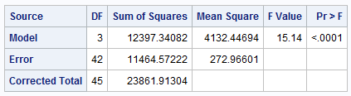
First Ask: Is there reason to believe any of them are different?
The reduced and full models are associated with Ho and Ha, respectively, although they are not exactly equal to the hypotheses.
(Ho) Reduced Model: µ µ µ µ
(Ha) Full Model: µ₁ µ₂ µ₃ µ₄
There is evidence to suggest that at the alpha = .05 level of significance (p-value < .0001) that at least 2 of the sites have different mean depths.

Slide 33
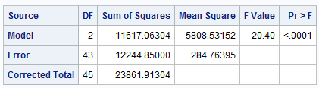
Question of Interest: 1. Are the means of sites 1 and 4 different?
Compare this model against equal means model (µ µ µ µ)
*Recode the variables into three groups: 2, 3, and 1/4 combined and perform ANOVA to get the first table.
(Ho) Reduced Model: µ_{o} µ₂ µ₃ µ_{o}
(Ha) Full Model: µ₁ µ₂ µ₃ µ₄
Compare this model against equal means model (µ µ µ µ)
(Ho) Reduced: µ µ µ µ
(Ho) Reduced: µ µ µ µ
(Ha) Full*: µ_{o} µ₂ µ₃ µ_{o}
(Ha) Full: µ₁ µ₂ µ₃ µ₄
Source | DF | SS | MS | F | Pr>F
Model (Full) | 1 | 780.3 | 780.3 | 2.86 | .098
Error (From Full) | 42 | 11464.6 | 273.0
Total (From Reduced*) | 43 | 12244.9
There is not enough evidence to suggest (alpha = .05, p-value = .098) that site 1 and site 4 have different mean depths.

Slide 34
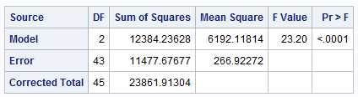
Question of Interest: (try it!) 2. Are the means of sites 2 and 3 different?
*Recode the variables into three groups: 1, 4, and 2/3 combined and perform ANOVA to get the first table.
(Ho) Reduced Model:
(Ha) Full Model:
µ₁ µ_{o} µ_{o} µ₄
µ₁ µ₂ µ₃ µ₄
(Ho) Reduced:
(Ha) Full*:
µ µ µ µ
µ₁ µ_{o} µ_{o} µ₄
(Ho) Reduced:
(Ha) Full:
µ µ µ µ
µ₁ µ₂ µ₃ µ₄
Source | DF | SS | MS | F | Pr>F
Model (Full)
Error (From Full)
Total (From Reduced*)

Slide 35
Question of Interest: (try it!) 2. Are the means of sites 2 and 3 different?
*Recode the variables into three groups: 1, 4, and 2/3 combined and perform ANOVA to get the first table.
(Ho) Reduced Model:
(Ha)Full Model:
µ₁ µ_{o} µ_{o} µ₄
µ₁ µ₂ µ₃ µ₄
(Ho) Reduced:
(Ha) Full*:
µ µ µ µ
µ₁ µ_{o} µ_{o} µ₄
(Ho) Reduced:
(Ha) Full:
µ µ µ µ
µ₁ µ₂ µ₃ µ₄
Source | DF | SS | MS | F | Pr>F
Model (Full)
Error (From Full) | 42 | 11464.6 | 273
Total (From Reduced) | 43 | 11477.7

Slide 36
Question of Interest: (try it!) 2. Are the means of sites 2 and 3 different?
*Recode the variables into three groups: 1, 4, and 2/3 combined and perform ANOVA to get the first table.
(Ho) Reduced Model:
(Ha) Full Model:
µ₁ µ_{o} µ_{o} µ₄
µ₁ µ₂ µ₃ µ₄
(Ho) Reduced:
(Ha) Full*:
µ µ µ µ
µ₁ µ_{o} µ_{o} µ₄
(Ho) Reduced:
(Ha) Full:
µ µ µ µ
µ₁ µ₂ µ₃ µ₄
Source | DF | SS | MS | F | Pr>F
Model (Full) | 1 | 13.1 | 13.1 | .048 | .828
Error (From Full) | 42 | 11464.6 | 273
Total (From Reduced) | 43 | 11477.7
There is not enough evidence to suggest (alpha = .05, p-value = .828) that site 2 and site 3 have different mean depths.

Slide 37
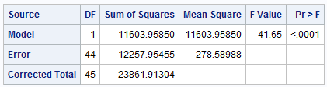
Question of Interest: 3. Are sites 1 and 4 different than 2 and 3?
*Recode the variables into two groups 1/4 and 2/3 and perform ANOVA to get the table.
(Ho) Reduced: µ µ µ µ
(Ha) Full: µ_{b} µ_{a} µ_{a} µ_{b}
There is sufficient evidence to suggest (alpha = .05, p-value < .0001) that sites 1 and 4 have different mean depths than sites 2 and 3.

Slide 38
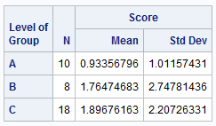

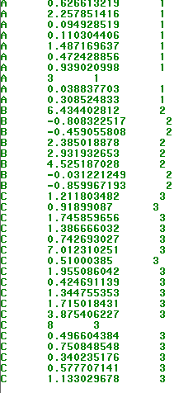
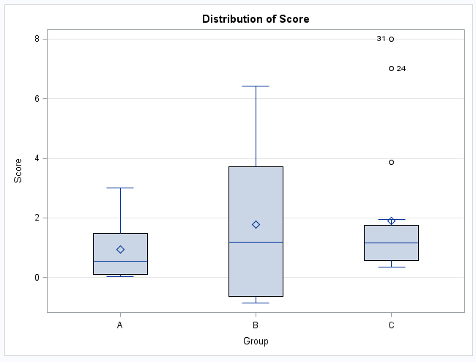
A Small Example

Slide 39
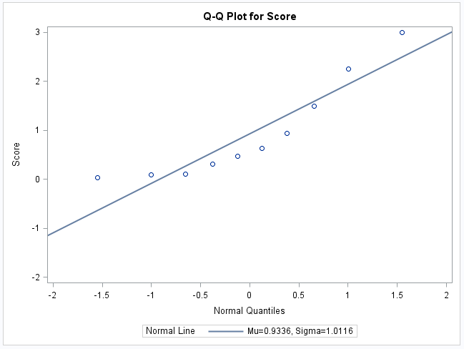
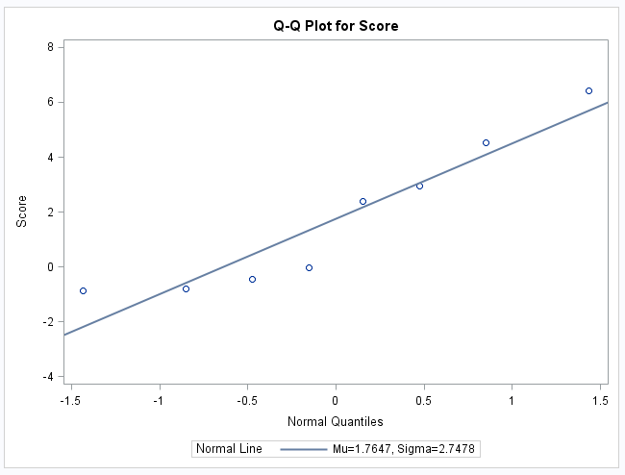
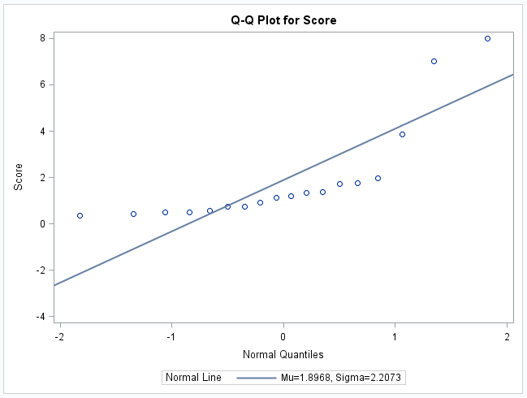
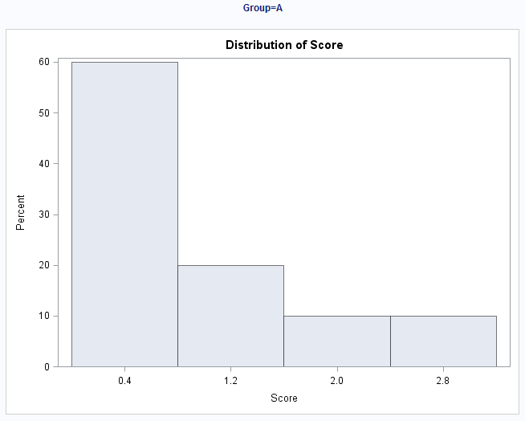
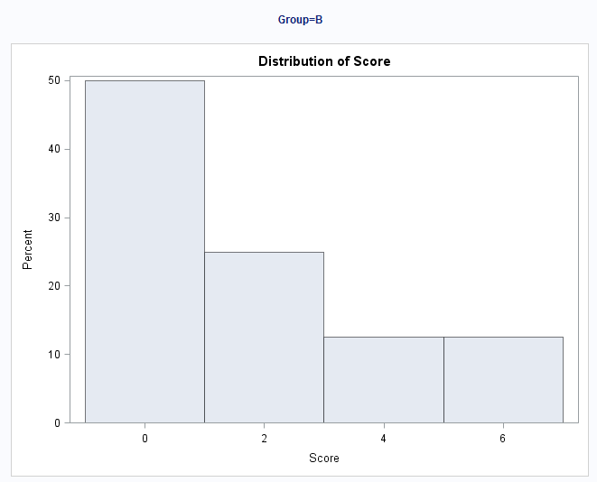


Normality Assumption
There is strong evidence against these data coming from a normal distribution and the sample size is small. ANOVA? WELCH’S ANOVA?

Slide 40



Homogeneity of Variance Assumption
There is strong evidence in support of these data coming from distributions with different standard deviations. If the standard deviation assumption and normality assumption are both violated, what should we do?
.

Slide 41

So …. NONPARAMETRIC!!!!

Slide 42



Kruskal-Wallis Test
There is not sufficient evidence at the alpha = .05 level of significance (p-value = .3766 from Kruskal-Wallis Test) to suggest that at least two of the medians are different.
Notice that each test failed to reject their respective Ho. The point isn’t so much that one test will reject when the other will fail to reject. We must remember that as statisticians, we don’t personally favor one outcome over the other. We just want the appropriate test: the one with the most power. Kruskal-Wallis Test is the appropriate test.

Slide 43





Another Analysis!!!!
…

Slide 44



Normality Assumption
There is strong evidence in favor of these data coming from a normal distribution. We will proceed under this assumption.

Slide 45





Assumptions and Analysis:
There is strong evidence in support of these data coming from distributions with different standard deviations. We will proceed under this assumption and run the Welch’s ANOVA.
Regular ANOVA:
There is sufficient evidence at the alpha = .05 level of significance (p-value = .0201 from Welch’s ANOVA) to suggest that at least two of the means are different.

Slide 46


Performance of Welch’s Test

Slide 47
Fixed Effects vs. Random Effects
Quick answer:
Do your groupings exhaust the data (e.g., data on four different machines and there are only four machines)? Fixed Effects! Use Proc GLM in SAS.
Are your groupings a random sample of a larger population that could have been chosen to be a group (e.g., data on four different machines that were chosen from a random sample of 100 machines)? Random Effects! Use Proc Mixed in SAS.

Slide 48
Fixed or random effects
Measured the amount of liquid in twenty randomly selected cans of Coke and twenty randomly selected cans of Diet Coke at a regional bottling company. Coke and Diet Coke are bottled using different types of machines.
Scenario 1: There is only one machine of each type.
Fixed Effects
Scenario 2: There are several of each type of machine. The Coke samples all came from the same Coke bottling machine, and the Diet Coke samples all came from the same Diet Coke machine.
Random effects

Slide 49
APPENDIX

Slide 50


What does $r^{2}$ mean?
$r^{2}$ is called the coefficient of determination, or square of the correlation coefficient
$r^{2}=\frac{{SS}_{model}}{{SS}_{total}}$
We can think of $r^{2}$ as the proportion of variability that is explained by the independent variables (grouping data).

Slide 51

What does $r^{2}$ mean?
While $r^{2}$is gleaned from the data, the true parameter is referred to as $ρ$ (rho).
The following two hypothesis tests are equivalent:
1
$$H_{0}: μ_{1}=μ_{2}=⋯=μ_{k}$$
$$H_{0}:at least 1 μ_{i} is different$$
Test statistic:
$F=\frac{MS(model)}{MS(error)}$, where $F$ is $F$ distributed with $k−1$, $n−k$ degrees of freedom
2
$$H_{0}: ρ=0$$
$$H_{0}:ρ≠0$$
Test statistic:
$F=\frac{r^{2}(n−k)}{\left(1−r^{2}\right)\left(k−1\right)}$, where $F$ is $F$ distributed with $k−1$, $n−k$ degrees of freedom
You can use algebra to prove the two test statistics are equivalent. Try it yourself!

Slide 52

What does $r^{2}$ mean?
Let $F_{1}=\frac{r^{2}(n−k)}{\left(1−r^{2}\right)\left(k−1\right)}$ and $F_{2}=\frac{MS(model)}{MS(error)}$, where $k$ is the number of groups and $n$ is the total number of data points.
Recall that
$r^{2}=\frac{{SS}_{model}}{{SS}_{total}}=\frac{{SS}_{total}−{SS}_{error}}{{SS}_{total}}=1−\frac{{SS}_{error}}{{SS}_{total}}$.
So, $1−r^{2}=\frac{{SS}_{error}}{{SS}_{total}}$.
Also remember that $MS\left(model\right)=\frac{SS(model)}{k−1}$ and $MS\left(error\right)=\frac{SS(error)}{n−k}$.
$$\frac{r^{2}(n−k)}{\left(1−r^{2}\right)\left(k−1\right)}=\frac{\frac{{SS}_{model}}{{SS}_{total}}(n−k)}{\frac{{SS}_{error}}{{SS}_{total}}\left(k−1\right)}=\frac{{SS}_{model}(n−k)}{{SS}_{error}\left(k−1\right)}=\frac{{SS}_{model}/(k−1) }{{SS}_{error}/\left(n−k\right)}=\frac{MS(model)}{MS(error)}$$
Therefore, $F_{1}=F_{2}$.

Slide 53

MSE vs. Variance in each group
MSE is a weighted average of the sample variances of each group. Let $s_{k}^{2}$ be the sample variance in group $k$.
$MSE=s_{p}^{2}=\frac{\left(n_{1}−1\right)s_{1}^{2}+\left(n_{2}−1\right)s_{2}^{2}+⋯+\left(n_{k}−1\right)s_{k}^{2}}{\left(n_{1}−1\right)+\left(n_{2}−1\right)+⋯+\left(n_{k}−1\right)}$
$$MSE=\frac{\left(n_{1}−1\right)s_{1}^{2}+\left(n_{2}−1\right)s_{2}^{2}+⋯+\left(n_{k}−1\right)s_{k}^{2}}{n−k}$$

Slide 54
Examples

Slide 55

Another example!
5 different sports were analyzed to see if the average height of basketball players was greater than the average of all the other sports. We could, of course, compare each pairwise grouping of sports, but that would result in 4 tests. This would take a lot of time, and those tests would each have less power since they don’t use all the data. Let’s use ANOVA similarly to how we did in prior problems.
Make a side by side box plot of the data.
Run a basic ANOVA to test for any pairwise difference of means. Check the assumptions here, but no need to address them after this.
Test the model that keeps basketball by itself but groups the other sports as “others.”
Use the previous two models to conduct an extra sum of squares F-Test:
Depending on the results of this test, test to see if there is evidence that basketball has a different mean than each of the sports. (Equivalent to testing basketball versus the others.)
Make sure and provide written conclusions for questions 2,3,4 and 5.
Ho: Reduced Model: µ_{B} µ_{O} µ_{O} µ_{O} µ_{O}
Ha: Full Model: µ_{B} µ_{F} µ_{Soc} µ_{Swim} µ_{T}
Ho: Reduced Model: µ_{O} µ_{O} µ_{O} µ_{O} µ_{O}
Ha: Full Model: µ_{B} µ_{O} µ_{O} µ_{O} µ_{O}

Slide 56

First … Plot the Data!

Slide 57











Plot the Data cont.
Normality: We have very small sample sizes here. There is not a lot of evidence against normality for each group, although there is not a lot of evidence to begin with. We will proceed with caution under the assumption of normal distributions for each sport.
Homogeneity of Variance: Judging from the box plots, there is some visual evidence against equal standard deviations, although the sample size is still small. A secondary test would be nice to lean on here.
We will assume the observations are independent both between and within groups.

Slide 58

Brown and Forsythe Test for Equality of Variance.
There is some visual evidence against equal standard deviations between sports. The Brown and Forsythe test was used as secondary evidence and does not provide significant evidence against equal standard deviations. (p-value = .9672)

Slide 59


1 Way ANOVA
Ho: µ_{Basketball} = µ_{Football}= µ_{Soccer} = µ_{Swim} = µ_{Tennis}
Ha: At least one pair of means is different.
There is strong evidence to suggest that the at least one of the sports has a mean height that is different than the others (p-value < .0001 from an ANOVA).

Slide 60







Ho: µ_{Basketball} = µ_{Football}= µ_{Soccer} = µ_{Swim} = µ_{Tennis}
Ha: At least one pair of means are different.
F-TEST
Ho: The Others are equal. (Including Basketball)
Ha: The Others are different (Including Basketball)
$$F=$$
$$F= \frac{(153.19 −141.56)/(30−27)}{141.56/27}$$
$$F=.74$$
Ho: µ_{Basketball} = µ_{Football}= µ_{Soccer} = µ_{Swim} = µ_{Tennis}
Ha: µ_{Basketball} is different than the Others.
P-value = $0.5375$
Fail to Reject Ho
There is not sufficient evidence at the alpha = .05 level of significance (p-value = 0.5375) to suggest that the mean heights of non-basketball sports are not equal. Therefore we will proceed as if they are equal.

Slide 61

Same Test as last slide ….
Different Notation
Ho: Reduced Model: µ µ µ µ µ
Ha: Full Model: µ_{B} µ_{F} µ_{Soc} µ_{Swim} µ_{T}
F-TEST
Ho: Reduced Model: µ_{B} µ_{O} µ_{O} µ_{O} µ_{O}
Ha: Full Model: µ_{B} µ_{F} µ_{Soc} µ_{Swim} µ_{T}
$$F=$$
$$F= \frac{(153.19 −141.56)/(30−27)}{141.56/27}$$
$$F=.74$$
Ho: Reduced Model: µ µ µ µ µ
Ha: Full Model: µ_{B} µ_{O} µ_{O} µ_{O} µ_{O}
Pvalue = $0.5375$
Fail to Reject Ho
There is not sufficient evidence at the alpha = .05 level of significance (p-value = 0.5375) to suggest that the mean heights of non-basketball sports are not equal. Therefore we will proceed as if they are equal.

Slide 62
µ_{B} µ_{F} µ_{Soc} µ_{Swim} µ_{T}
µ_{B} µ_{O} µ_{O} µ_{O} µ_{O}
F-TEST: Another Look
Ho: Reduced Model: µ_{B} µ_{O} µ_{O} µ_{O} µ_{O}
Ha: Full Model: µ_{B} µ_{F} µ_{Soc} µ_{Swim} µ_{T}
Source | DF | SS | MS | F | Pr > F
Model | 3 | 11.63 | 3.87 | .74 | 0.5375
Error | 27 | 141.56 | 5.24
Corrected Total | 30 | 153.19

Slide 63
Since we are proceeding under the assumption that the mean heights of the other sports (besides basketball) are equal, we can test whether basketball has a mean height different than the other sports by testing:
Ho: µ_{Basketball} = µ_{Others}
Ha: µ_{Basketball} ≠ µ_{Others}
There is strong evidence at the alpha = .05 level of significance (p-value < .0001) that supports the claim that the mean height of basketball players is different than that of the other 4 sports.

Slide 64
Resources
www.itl.nist.gov/div898/handbook/prc/section4/prc433.htm

Slide 65
Spock Example

Slide 66


Spock Trial
1968: Dr. Ben Spock was accused of conspiracy to violate the Selective Service Act by encouraging young men to resist being drafted into military service for Vietnam.
Jury Selection: A “venire” of 30 potential jurors is selected at random from a list of 300 names that were previously selected at random from citizens of Boston.
A jury is then selected NOT at random by the attorneys trying the case.
For this case, the venire consisted of only one woman, who was let go by the prosecution, thus resulting in an all male jury.
There was reason to believe that women were more sympathetic to Dr. Spock’s actions due to his popular child rearing books.
The defense argued that the judge in this case had a history of venires that underrepresented women, which is contrary to the law.
Let’s see if there is any evidence for this claim!

Slide 67

The Raw Data

Slide 68






Comparing Two Means From Many Groups.
Ho: µ_{S} = µ_{F}
Ha: µ_{S} ≠ µ_{F}
Judge | N | Xbar | Sd
Spock | 9 | 14.6 | 5.04
A | 5 | 34.1 | 11.94
B | 6 | 33.6 | 6.58
C | 9 | 29.1 | 4.59
D | 2 | 27.0 | 3.81
E | 6 | 27.0 | 9.01
F | 9 | 26.8 | 5.97
With 2 groups estimating the pooled SD.
$$t=\frac{{\overline{x}}_{1}−{\overline{x}}_{2}}{s_{p}\sqrt{\frac{1}{n_{1}}+\frac{1}{n_{2}}}}$$
$$CV=t_{.025,16}=±2.12$$
With all 7 groups estimating the pooled SD, bigger ‘n’ greater df! More POWER!!!
$$s_{p}=\sqrt{\frac{\left(9−1\right)∗{5.04}^{2}+\left(5−1\right)∗{11.94}^{2}+\left(6−1\right)∗{6.58}^{2}+\left(9−1\right)∗{4.59}^{2}+\left(2−1\right)∗{3.81}^{2}+\left(6−1\right)∗{9.01}^{2}+\left(9−1\right)∗{5.97}^{2}}{\left(9−1\right)+(5−1)+(6−1)+(9−1)+(2−1)+(6−1)+(9−1)}}$$
s_{p} = 6.91
$$CV=t_{.025,39}=±2.02$$
$$t=\frac{14.6−26.8}{6.91\sqrt{\frac{1}{9}+\frac{1}{9}}}=\frac{−12.2}{3.25}=−3.75$$
P-value = .0006
Reject $Ho$

Slide 69


Spock Data Steps
Question: Suppose we wish to test if the “S” judge’s venires are different from the “F” judge’s.

Slide 70


Two Judge Analysis w/ t-Tools
Statistical Conclusion: We find that there is substantial evidence that the difference in the mean percentage of females on judge S and judge F venires is not equal to zero.
Estimated Diff = -12.1778
Sp = 5.5234
Pooled Std. Error = 2.6038
t-Statistic = -4.68
Deg. of freedom = 16

Slide 71


Two Judge Analysis w/ Several-Groups
From PROC TTEST:
Estimated Diff = -12.1778
Sp = 5.5234
Pooled Std. Error = 2.6038
t-Statistic = -4.68
Deg. of freedom = 16
Deg. of freedom = 46 – 7 = 39

Slide 72

Two Judge Analysis: Conclusion
Question: Suppose we wish to test if the “S” judge’s venires are different from the “F” judge’s.
Answer: There is evidence that the mean of the two groups is different.
We can use regular t-Tools or several-group analysis.
The several-group analysis allows us to use all of the available information $→$larger degrees of freedom $→$ more power!

Slide 73
Spock Trial QOI 2
The defense argued that the judge in this case had a history of venires that underrepresented women, which is contrary to the law.
QOI2: Is the percent of women on recent venires of Spock’s judge (which we will call S) significantly lower than those of 6 other judges (which we notate A to F)?
There are two key questions:
Is there evidence that women are underrepresented on S’s venires relative to A to F’s?
Is there evidence of a difference in women’s representation on A to F’s venires?
The question of interest is addressed by 1
The strength of the result in 1 would be substantially diminished if 2 is true

Slide 74

Spock: The Strategy
Since we found that there was evidence that at least one of the means was different than the others, we will first (Step 1) test to see if there is evidence that the other 6 judges have similar mean female representation in their venires. If there is no evidence their means are different then (Step 2) we have them share a mean ($μ_{O})$ and compare Spock’s judge’s ($μ_{S})$mean with $μ_{O}$.

Slide 75
Step 1: Compare Judges A - F
Ho: All “other” means are equal (A, B, C, D, E, F)
Ha: At least 2 “other” means are different (A, B, C, D, E, F)
But … Let’s use all the data to estimate the pooled standard deviation!
Reduced Model: µ_{s} µ_{o} µ_{o} µ_{o} µ_{o} µ_{o} µ_{o}
Full Model: µ_{s} µ_{A} µ_{B} µ_{C} µ_{D} µ_{E} µ_{F}

Slide 76


Different Models in SAS
At Least 2 are different (S, A, B, … F)
µ_{s} µ_{A} µ_{B} µ_{C} µ_{D} µ_{E} µ_{F}
Spock is different than the Others
µ_{s} µ_{o} µ_{o} µ_{o} µ_{o} µ_{o} µ_{o}

Slide 77

Different Models in SAS
At Least 2 are different (S, A, B, … F)
µ_{s} µ_{A} µ_{B} µ_{C} µ_{D} µ_{E} µ_{F}
Spock is different than the Others
µ_{s} µ_{o} µ_{o} µ_{o} µ_{o} µ_{o} µ_{o}

Slide 78
Comparing Two Models: Both are not Equal Means Model
SAS (proc glm) compares models to the equal means model. When you run proc glm, it always makes the “Corrected Total Row” the equal means model. However, we can build our own ANOVA table (BYOA) to compare two models, both of which are not the equal means model.
To do this we will need to identify the “full” model and the “reduced” model. The “full” model will be the model with the most parameters (means) in it while the “reduced model” will have fewer parameters. (Note that the equal means model (with one parameter) is the most reduced model you can have.)
Extra Sum of Squares
Test / BYOA
Source | DF | SS | MS | F | Pr > F
Model
Error
Corrected Total
Separate Means Model
(Full Model)
Equal Means Model
(Reduced Model)

Slide 79


At least 2 are different (Spock, A, B, C … F)
Spock is different than others
µ_{s} µ_{A} µ_{B} µ_{C} µ_{D} µ_{E} µ_{F}
µ_{s} µ_{o} µ_{o} µ_{o} µ_{o} µ_{o} µ_{o}
F-TEST: Another Look
Ho: µ_{A}, µ_{B}, µ_{C} …. µ_{F} are Equal
Ha: At least 2 are different (A,B,C …F)
Reduced : µ_{s} µ_{o} µ_{o} µ_{o} µ_{o} µ_{o} µ_{o}
Full: µ_{s} µ_{A} µ_{B} µ_{C} µ_{D} µ_{E} µ_{F}
Source | DF | SS | MS | F | Pr > F
Model | 5 | 326.5 | 65.29 | 1.37 | 0.26
Error | 39 | 1864.4 | 47.81
Corrected Total | 44 | 2190.9
Full
Reduced

Slide 80




EXTRA SUMS OF SQUARES F TEST
F-TEST
Ho: All means are equal (Spock,A,B,C…,F)
Ho: µ_{A} – µ_{F} are Equal
Ha: At least 2 are different (Spock,A,B,….F)
Ha: At least 2 are different (A,B, .. F)
$$F=$$
$$F= \frac{(2190.9 −1864.4)/(44−39)}{1864.4/39}$$
$$F=1.37$$
Ho: Spock is equal to Others
P-value = $0.26$
Ha: Spock is diff from Others
Fail to Reject Ho
There is not sufficient evidence at the alpha = .05 level of significance (p-value = 0.26) to suggest that the means are not equal. Therefore, we will proceed as if they are equal.

Slide 81
Step 1 Complete!
There is not sufficient evidence to suggest that the mean percent of women on judge’s A-F venires are different from one another (p-value = .26 from an ANOVA). Therefore, we will now move on to Step 2 and compare Spock’s judge’s mean to the single mean that will represent the other judges.
F-TEST: Another Look
Ho: µ_{A}, µ_{B}, µ_{C} …. µ_{F} are Equal
Ha: At least 2 are different (A,B,C …F)
Source | DF | SS | MS | F | Pr > F
Model | 5 | 326.5 | 65.29 | 1.37 | 0.26
Error | 39 | 1864.4 | 47.81
Corrected Total | 44 | 2190.9

Slide 82

Step 2!
Since we are proceeding under the assumption that the mean percentage of women in venires of the non-Spock judges are equal, we can test whether the Spock judge has a mean percentage different than the other judges by testing:
Ho: Mean of Spock is equal to the mean of the others.
Ha: Mean of Spock is different than the mean others.
There is strong evidence at the alpha = .05 level of significance (p-value < .0001 from an ANOVA) to support the claim that the mean percentage of women in the Spock judge’s venires is less than that of the other 6 judges and that there is no evidence that the other 6 judges have different mean percentages of women on their venires (p-value = .26 from an Extra Sum of Squares F Test). Spock’s lawyer has evidence for a mistrial.

